Slide 1
C - Typedef
Abu Sayeed
Assistant Professor
Department of Computer Science & Engineering

Slide 2
C - Typedef
Typedef is a keyword that is used to give a new symbolic name for the existing name in a C program.
This is same like defining alias for the commands. Consider the below structure.
struct student { int mark [2]; char name [10]; float average; }
Variable for the above structure can be declared in two ways.
1st way :
struct student record; /* for normal variable */ struct student *record; /* for pointer variable */
2nd way :
typedef struct student status;
When we use “typedef” keyword before struct <tag_name> like above, after that we can simply use type definition “status” in the C program to declare structure variable.
Now, structure variable declaration will be, “status record”.
This is equal to “struct student record”. Type definition for “struct student” is status. i.e. status = “struct student”

Slide 3
C - Typedef
An alternative way for structure declaration using typedef in C:
typedef struct student { int mark [2]; char name [10]; float average; } status;
To declare structure variable, we can use the below statements.
status record1; /* record 1 is structure variable */ status record2; /* record 2 is structure variable */

Slide 4
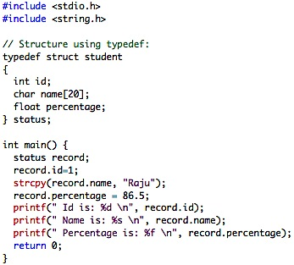
Example program for C Typedef
Output:
id is: 1
Name is: Raju
Percentage is: 86.500000

Slide 5
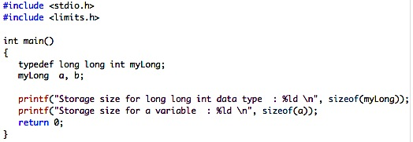
C - Typedef
Typedef can be used to simplify the real commands as per our need.
For example, consider below statement.
typedef long long int myLong;
In above statement, myLong is the type definition for the real C command “long long int”.
We can use type definition myLong instead of using full command “long long int” in a C program once it is defined.
Output:
Storage size for long long int data type : 8
Storage size for a variable : 8

